Slide 1
Lane Detection using the concept of Deep Learning and Digital Image Processing
Shashi Kant Ojha
Abhishek Kumar
Notes:
_x0010_Esten is at the CDC conference
Bulk of talk will introduce this one algorithm (high level & quick), and then give our results

Slide 2
Motivation
Autonomous driving
Driver assistance (collision avoidance, more precise driving directions)

Slide 3
Some Terms
Lane detection - draw boundaries of a lane in a single frame
Lane tracking - uses temporal coherence to track boundaries in a frame sequence
Vehicle Orientation- position and orientation of vehicle within the lane boundaries

Slide 4
Goals of our lane tracker
Recover lane boundary for straight or curved lanes in suburban environment
Recover orientation and position of vehicle in detected lane boundaries
Use temporal coherence for robustness
Notes:
First 2 given based on lane model

Slide 5
Starting with lane detection
Extended the work of Lopez et. al. 2005’s work on lane detection
  Ridgel feature
  Hyperbola lane model
  R-CNN Moel for model fitting
  Realtime
Notes:
If you recall, we implemented another Lane tracker by Zhou, with goal of making it realtime, it was really far from realtime

Slide 6
The Setup
Data: University of Sydney (Berkeley-Sydney Driving Team)
  640x480, grayscale, 24 fps
  Suburban area of Sydney
Lane Model: Hyperbola
  2 lane boundaries
  4 parameters
    2 for vehicle position and orientation
    2 for lane width and curvature
Features: Ridgels
  Picks out the center line of lane markers
  More robust than simple gradient vectors and edges
Fitting: R-CNN
  Robustly fit lane model to ridgel features
Notes:
Lots of lane trackers test on high speed highway video

Slide 7
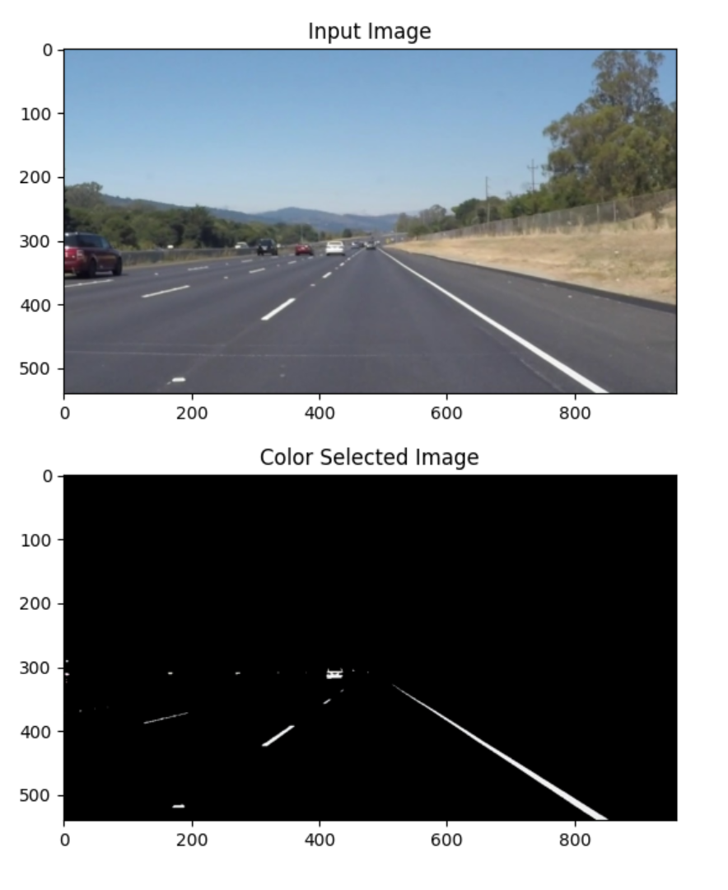
Setup
Notes:
Faded markings, one sided markings, lots of clutter

Slide 8
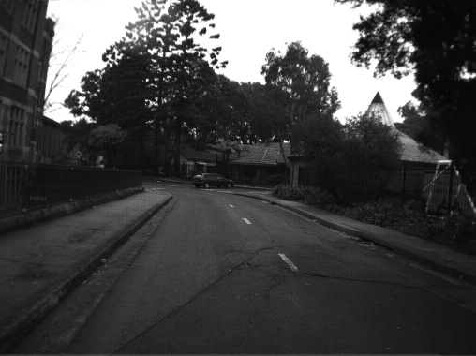
Setup
Notes:
Dynamic range of the image also changes

Slide 9

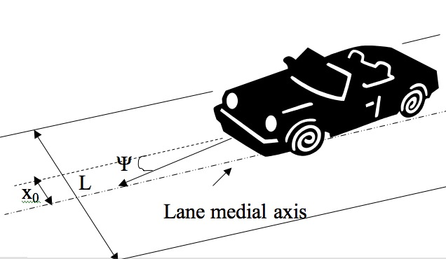
Lane Model
Assumes flat road, constant curvature
L and K are the lane width and road curvature
Θ is the pitch of the camera, assumed to be fixed
Notes:
Our model will estimate…

Slide 10
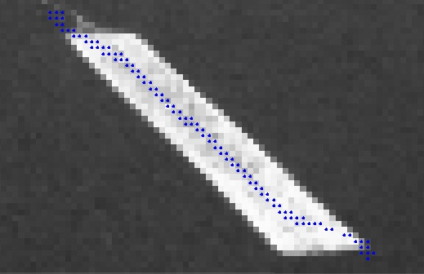
Ridgel Feature
Center line of elongated high intensity structures (lane markers)
Originally proposed for use in rigid registration of CT and MRI head volumes

Slide 11
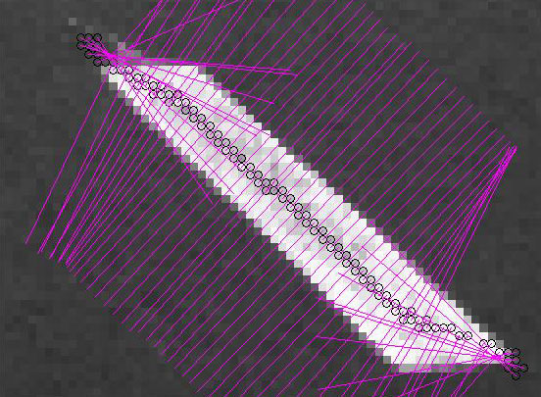
Ridgel Feature
Recovers dominant gradient orientation of pixel
Invariance under monotonic-grey level transforms (shadows) and rigid movements of image
Notes:
Purple lines denote dominant gradient orientation

Slide 12
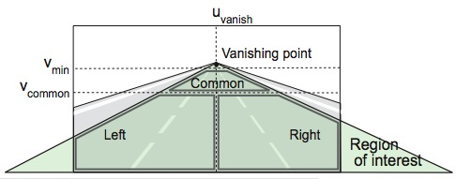
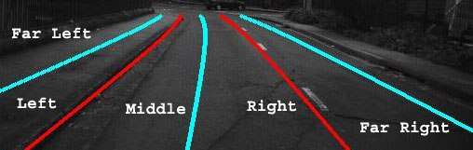
Classifying and removing ridgels
Using the previous lane boundary
  Dynamically classify left and right ridgels
  per row image gradient comparison
  “far left” and “far right” ridgels removed

Slide 13
Velocity Measurements
Optical encoder provides velocity
Model for vehicle motion
  Updates lane model parameters such as speed, velocity, displacement and time per frame and also display it.

Slide 14
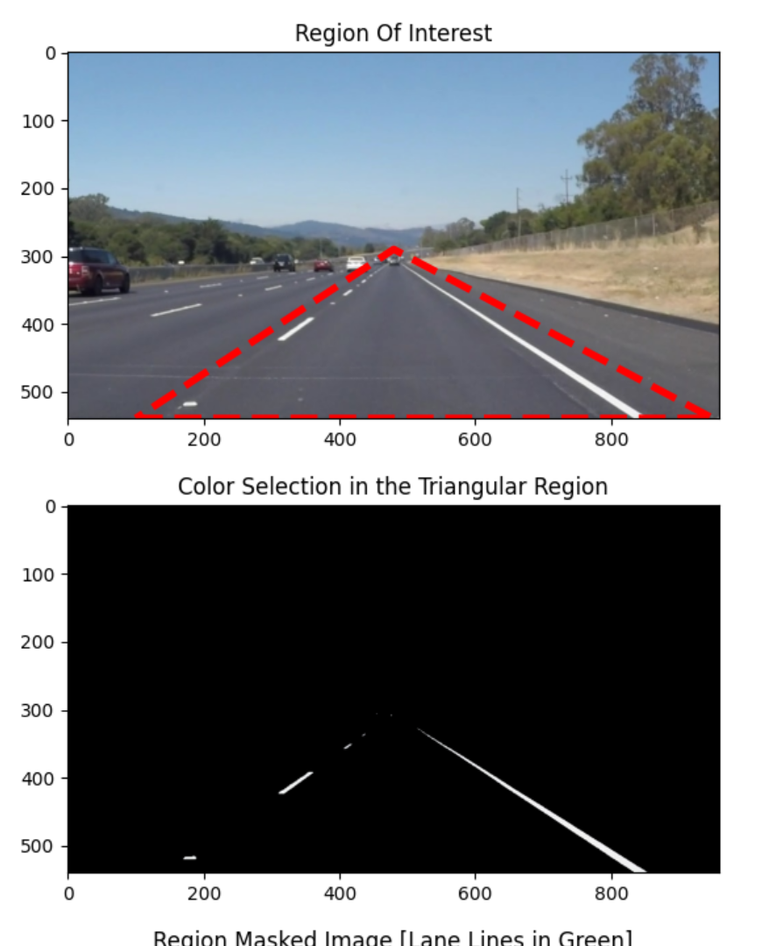
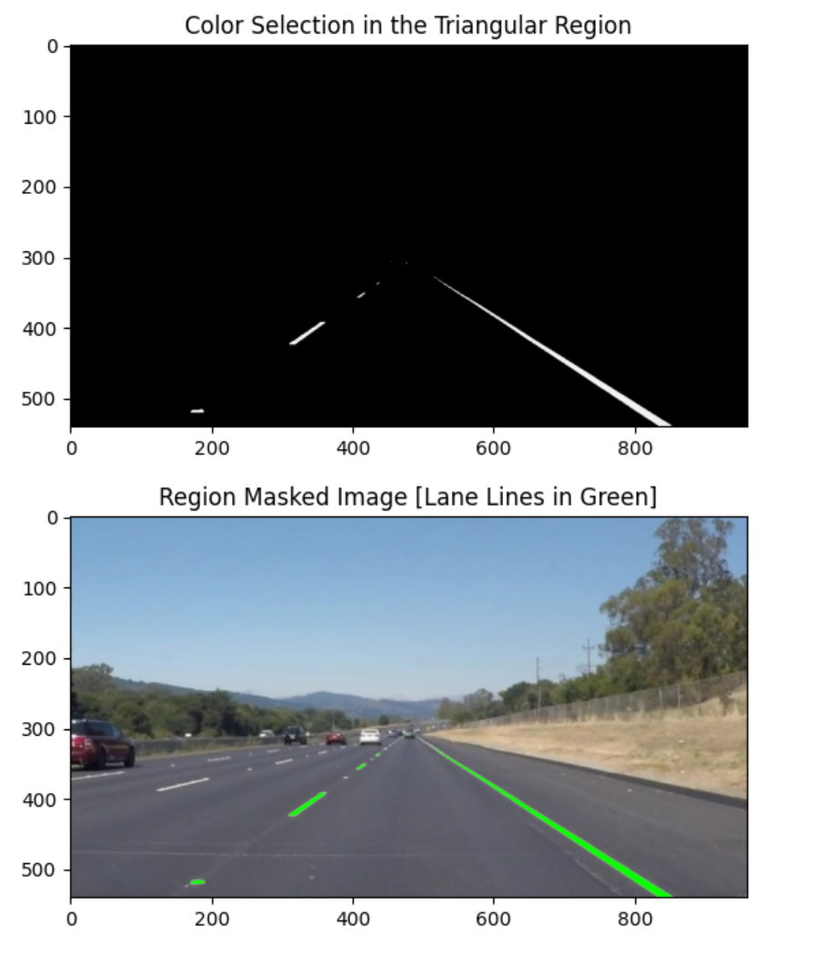
Results

Slide 15
Conclusion
Robust by incorporating temporal features
  Still needs work
Theoretical speed up by pruning ridgel features
Ridgel feature robust
Lane model assumptions may not hold in non-highway roads

Slide 16
Future Work
Exploration of advanced deep learning architectures and techniques for further improving lane detection performance, such as attention mechanisms and reinforcement learning.
Integration with other sensor modalities such as LiDAR and radar for multi-sensor fusion and enhanced perception capabilities.
Research on real-time optimization algorithms and hardware acceleration techniques to improve computational efficiency and enable deployment on resource-constrained platforms.

Slide 17
Important works reviewed/considered
Zhou. et. al. 2006
  Particle filter and Tabu Search
  Hyperbolic lane model
  Sobel edge features
Zu Kim 2006
  Particle filtering and RANSAC
  Cubic spline lane model
  No vehicle orientation/position estimation
  Template image matching for features

